Slide 1
STAT 7900: Special Topic:
Causal Analysis
Instructor
Dhrubajyoti Ghosh
KENNESAW STATE UNIVERSITY
STAT 7900

Slide 2
The four assumptions — big picture
What they mean • why we need them • what happens when they fail
Consistency
Exchangeability
Positivity
SUTVA / No interference
These assumptions are what allow an observed-data analysis to be interpreted causally.

Slide 3
Four Causal Assumptions
1. Consistency
2. Exchangeability
The observed outcome equals the potential outcome under the treatment received.
After conditioning on the right covariates, treatment assignment carries no extra information about the potential outcomes.
3. Positivity
4. SUTVA / no interference
Within relevant covariate strata, every treatment option has a nonzero chance of being observed.
Treatment is well defined, and one person’s treatment does not change another person’s outcome.
All four matter. Different assumptions fail in different ways.

Slide 4
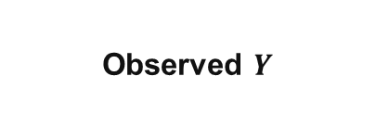
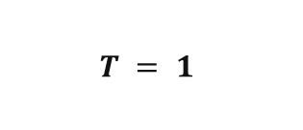
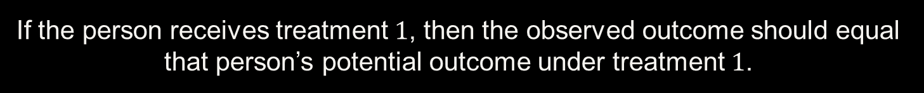

Assumption 1: Consistency
$$T = 1$$
Observed $Y$
=
$$Y(1)$$
If the person receives treatment $1$, then the observed outcome should equal that person’s potential outcome under treatment $1$.
Consistency connects the observed outcome $Y$ to the counterfactual notation $Y(t)$.

Slide 5
Assumption 1: Consistency
Question: Does taking 10 mg of Drug A reduce systolic blood pressure after 4 weeks?
Treatment definition
Why consistency is plausible
T = 1 means:
• Drug A
• 10 mg daily
• for 4 weeks
People labeled T = 1 are receiving essentially the same intervention that defines Y(1).
The clearer the intervention, the easier consistency is to defend.

Slide 6
Assumption 1: Consistency
Walking
20 min/week
Running
5 days/week
Strength
training
Mixed
program
All four people are coded T = 1, but these are not the same intervention.
If treatment versions matter for Y, then “Y(1)” is ambiguous.

Slide 7
Assumption 2: Exchangeability
Can the treated and untreated groups stand in for each other’s counterfactual outcomes?
Ideal comparison
Why we need it
Apart from treatment, the groups are comparable with respect to factors that determine the outcome.
We use untreated people to learn what would have happened to treated people without treatment, and vice versa.
No unblocked confounding
Exchangeability is the assumption that makes between-person comparisons informative about counterfactuals.

Slide 8

Assumption 2: Exchangeability
Exchangeability in a randomized trial
C
T
Y
no systematic arrow $C → T$
Exchangeability in observational data
Treatment T
T ← C → Y
Severity C
Outcome Y

Slide 9

Conditional Exchangeability
Observational studies usually rely on exchangeability after conditioning on X.
$$Y(t) ⟂ T | X$$
Interpretation
Critical limitation
Within people with the same relevant X, treatment behaves “as if randomized” with respect to the potential outcomes.
This only works if X actually contains enough information to block the important backdoor paths.
This is exactly why DAGs matter: they help justify what belongs in X.

Slide 10

Assumption 3: Positivity
For every kind of person we want to compare, we need some treated and some untreated observations.
$$0 < P(T = t | X = x) < 1$$
Plain language
Why we need it
Within each relevant covariate stratum, treatment cannot be impossible or guaranteed.
Without both treatment options represented, the missing counterfactual must be extrapolated rather than learned from data.
Positivity is an overlap requirement.

Slide 11
Assumption 3: Positivity
Example: patients with a contraindication NEVER receive the drug.
Stratum X = contraindication
Consequence
P(T = 1 | X) = 0
There are no treated patients in this stratum.
The treated potential outcome for this group is unsupported by observed data.
More data will not fix a structural zero.
Positivity can fail because of design, clinical rules, geography, policy, or extreme covariate combinations.

Slide 12
Assumption 3: Positivity
Structural vs practical positivity problems
Structural violation
Practical violation
Treatment truly cannot occur in a stratum.
Example: pregnancy is an absolute contraindication for a specific drug.
Treatment is possible but extremely rare.
Example: 2 treated patients versus 500 untreated patients in a covariate region.
The assumption is theoretical; overlap diagnostics are empirical clues.

Slide 13
Assumption 4: SUTVA / No Interference
SUTVA is easiest to understand as two separate ideas.
A. No interference
B. No hidden treatment versions
One person’s treatment does not change another person’s outcome.
“Treatment 1” corresponds to a sufficiently well-defined intervention.
SUTVA tells us whose treatment can affect whose outcome — and what exactly “treatment” means.

Slide 14
Assumption 4: SUTVA / No Interference
Example: vaccination in an infectious-disease study
Person A
Vaccinated
Person B
Outcome
A’s vaccination may reduce B’s infection risk.
Then B’s outcome depends not only on B’s own treatment, but also on A’s treatment.

Slide 15
Assumptions summary
Consistency
Exchangeability
Positivity
SUTVA
Does observed Y correspond
to Y(t)?
Are treatment groups
comparable?
Do both treatment options
exist across X?
Is treatment well defined,
without interference?
If any assumption fails, the causal interpretation can fail.

Slide 16


Slide 17

Why DAG?
The potential-outcomes assumption leaves us with a practical question.
$$Y(t) ⟂ T | X$$
Within levels of X, treatment assignment carries no additional information about the potential outcomes.
BUT WHAT BELONGS IN X?
Age? Baseline severity? Mediator? Every measured variable?
A DAG helps us decide which variables to adjust for, and which variables NOT to adjust for.

Slide 18

Three Building Blocks
CHAIN
FORK
COLLIDER
X $→$ Z $→$ Y
X ← Z → Y
X → Z ← Y
Open by default.
Blocked when conditioned on Z.
Open by default.
Blocked when conditioned on Z.
Blocked by default.
Open when conditioned on Z.
Conditioning behaves differently in the collider.

Slide 19


d-Separation ≠ Causal Adjustment
d-SEPARATION
Question:
Can we make T and Y conditionally independent?
Goal: BLOCK ALL paths.
CAUSAL ADJUSTMENT: TOTAL EFFECT
Question:
What should we condition on to identify the total effect?
Goal: BLOCK NONCAUSAL backdoor paths.
Example:
Backdoor path:
T $←$ C $→$ Y
C
Causal path:
T $→$ M $→$ Y
T
M
Y
For total effect: adjust for C,
not M.

Slide 20
d-Separation vs Causal Adjustment
d-separation
Causal adjustment
Goal: conditional independence
Block all open paths between two nodes
Useful for reading conditional independences from a DAG
Goal: identify the total causal effect
Block noncausal backdoor paths
Preserve causal paths from T to Y

Slide 21
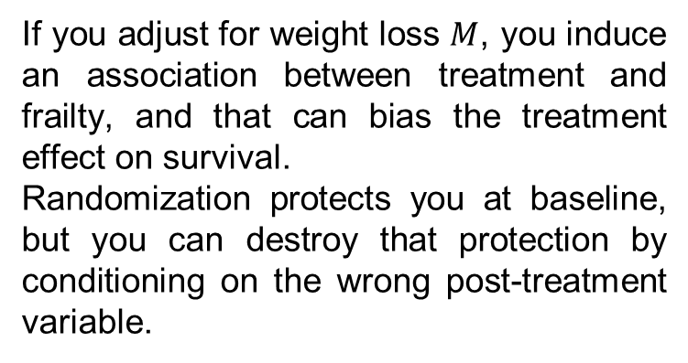

Collider adjustment bias with randomized T
T
U
Conditioning on M opens:
T → M ← U → Y
M
Y
If you adjust for weight loss $M$, you induce an association between treatment and frailty, and that can bias the treatment effect on survival.
Randomization protects you at baseline, but you can destroy that protection by conditioning on the wrong post-treatment variable.
Example:
T: randomized chemotherapy
$M$: treatment-induced weight loss
$U$: underlying frailty
$Y$: survival

Slide 22

M-bias
U₁
U₂
Without adjusting for M, the path
$T ← U₁ → M ← U₂ → Y$is blocked at M.
M
observed collider
T
Y
Not every predictor of treatment or outcome is a confounder.
A variable can be statistically associated with both T and Y yet still be a bad adjustment variable.
Real-world covariate choice should combine subject-matter knowledge, temporal ordering, and causal structure.

Slide 23
Overadjustment Bias
Overadjustment usually means conditioning on a variable that lies on, or is caused by, a causal pathway you intend to estimate.
T
M
Y
Adjust for M → estimated “effect of T” no longer contains T $→$ M $→$ Y.

Slide 24
Selection Bias
D
R
disease
risk factor
H
hospitalized
If your dataset contains only H = 1 patients, you have conditioned on a collider.
Inside the hospital, D and R can appear associated even if they are independent in the population.

Slide 25
How to draw a DAG from a research question
1. Define treatment/exposure T and outcome Y clearly.
2. List causes of T, causes of Y, and common causes.
3. Add plausible mediators and important selection variables.
4. Respect temporal ordering whenever possible.
5. Draw arrows from cause to consequence, not from correlation to correlation.
6. Use the graph to inspect backdoor paths and identify adjustment sets.

Slide 26
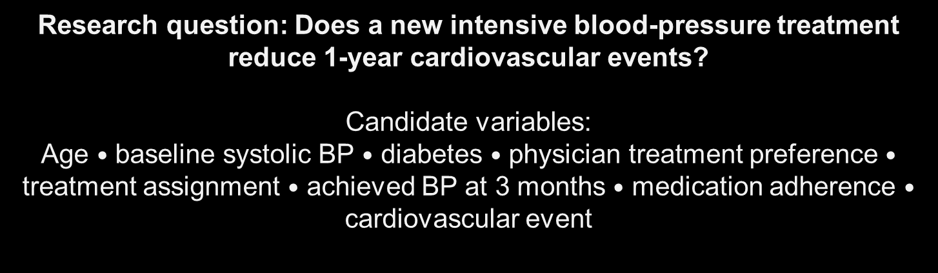
Build a graph
Research question: Does a new intensive blood-pressure treatment reduce 1-year cardiovascular events?
Candidate variables:
Age $•$ baseline systolic BP $•$ diabetes $•$ physician treatment preference $•$ treatment assignment $•$ achieved BP at 3 months $•$ medication adherence $•$ cardiovascular event
Draw plausible DAG. Circle the variables you would adjust for to estimate the TOTAL treatment effect.

Slide 27
One plausible DAG
Age
BP
DM
Pref
T
3m BP
Adh
Y

Slide 28
First: Specify the Estimand
What exactly are we trying to estimate from this DAG?
Assume our target is the TOTAL effect of treatment T on cardiovascular outcome Y.

Slide 29
Total Effect Means …
Keep every causal pathway that begins at treatment T and ends at Y.
Block open backdoor paths that begin with an arrow into T.
Do not automatically adjust for post-treatment variables.
Do not automatically adjust for variables simply because they predict Y.
The estimand comes first; the adjustment set follows from the estimand + DAG.

Slide 30
Classify the variables by time
Baseline / pre-treatment
Post-treatment
Age
Baseline BP
Diabetes (DM)
Physician preference
3-month BP
Adherence
Cardiovascular outcome Y

Slide 31
Causal paths from T to Y
Path 1
T → Y
Path 2
T → 3m BP → Y
Path 3
T → 3m BP → Adh → Y
These are the pathways we want to KEEP OPEN when the target is the total effect.

Slide 32
Open Backdoor paths from T to Y
Path 4
T ← BP → Y
Path 9
T ← DM → 3m BP → Adh → Y
Path 5
T ← BP → DM → 3m BP → Y
Path 10
T ← Age → BP → Y
Path 6
T ← BP → DM → 3m BP → Adh → Y
Path 11
T ← Age → BP → DM → 3m BP → Y
Path 7
T ← DM ← BP → Y
Path 12
T ← Age → BP → DM → 3m BP → Adh → Y
Path 8
T ← DM → 3m BP → Y
Every backdoor path starts with an arrow INTO T. We need to block all of them, not just one.

Slide 33
A collider blocked T to Y path
T → 3m BP ← DM ← BP → Y
Path 13
Why is it closed?
T → 3m BP ← DM
3m BP is a collider:
Without conditioning on 3m BP
Condition on 3m BP (or descendant Adh)
Path 13 is CLOSED
Path 13 can OPEN
So 3m BP is dangerous twice: it is a mediator on causal paths and a collider on Path 13.

Slide 34
Finding minimal adjustment set
Block every open noncausal path from T to Y — while leaving the causal pathways open.
Goal
Step 1
Step 2
Step 3
Find a path that forces a variable into the adjustment set.
See which other backdoor paths are automatically blocked.
Add another variable only if an open backdoor path remains.
Minimal = every included variable is necessary; remove one and at least one backdoor path reopens.

Slide 35
Finding minimal adjustment set
Path 4
T ← BP → Y
Adjust for BP
Open backdoor path. BP is the only internal node.
To block this path, there is only one option:
Why can’t we use Age or DM to block Path 4?
Because neither Age nor DM lies on this particular path. Conditioning on an off-path variable does not block the path.
Therefore, every valid standard adjustment set for this DAG must contain BP.

Slide 36
Once we adjust for BP, many paths disappear
T ← BP → Y
BLOCKED by BP
Path 4
Path 5
T ← BP → DM → 3m BP → Y
BLOCKED by BP
Path 6
T ← BP → DM → 3m BP → Adh → Y
BLOCKED by BP
Path 7
T ← DM ← BP → Y
BLOCKED by BP
Path 10
T ← Age → BP → Y
BLOCKED by BP
Path 11
T ← Age → BP → DM → 3m BP → Y
BLOCKED by BP
Path 12
T ← Age → BP → DM → 3m BP → Adh → Y
BLOCKED by BP

Slide 37
After adjusting for BP, what remains open?
Only two backdoor paths do not contain BP:
Path 8
T ← DM → 3m BP → Y
BP does not appear on this path, so BP cannot block it.
Path 9
T ← DM → 3m BP → Adh → Y
Again, BP is not on the path.
So, BP alone is NOT sufficient.
We need one more baseline variable to close Paths 8 and 9.

Slide 38
DM closes the remaining two paths
Only two backdoor paths do not contain BP:
Path 8
T ← DM → 3m BP → Y
Path 9
T ← DM → 3m BP → Adh → Y
Condition on DM
Both paths are blocked immediately at DM.
{ BP, DM }

Slide 39
Why not block using 3-month BP or adherence?
Mathematically, conditioning on 3m BP or Adh could block those individual paths.
But they are post-treatment variables.
3-month BP
Adherence
T → 3m BP → Y
T → 3m BP → Adh → Y
Mediator on a causal pathway
Also lies downstream of treatment
For the TOTAL effect, block backdoor paths using baseline variables, not mediators.

Slide 40
Why isn’t Age required?
Age creates backdoor paths, but every Age path passes through BP:
Path 10
T ← Age → BP → Y
Path 11
T ← Age → BP → DM → 3m BP → Y
Path 12
T ← Age → BP → DM → 3m BP → Adh → Y
Because BP is already in the adjustment set, all three paths are already blocked.
Age may be included, but it is not necessary for a minimal sufficient set.

Slide 41
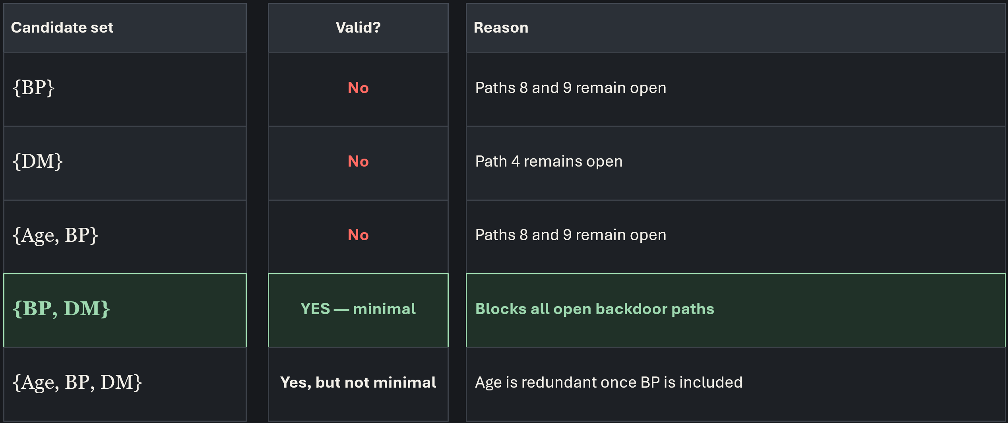
Valid vs minimal adjustment sets
Minimal does not mean “fewest variables possible” in general; it means no variable in the chosen valid set is redundant.

Slide 42
Collider logic is path-specific
Example 1: A backdoor path with a collider
Path: T ← C → V → M ← L → U → O
T
C
V
M
L
U
O
COLLIDER
No adjustment is needed to close this particular path.

Slide 43
Collider logic is path-specific
Example 1: What if we condition on C?
Path: T ← C → V → M ← L → U → O
T
C
V
M
L
U
O
C is a non-collider on this path.
Conditioning on C blocks the path at C.
M is still an unconditioned collider.
So the path is also closed at M.
Result: the path remains CLOSED.

Slide 44
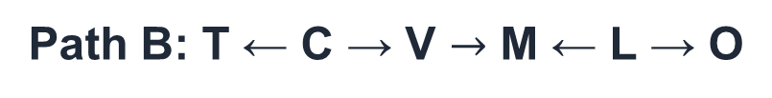

Collider logic is path-specific
Example 2: Now suppose we have arrow from M -> 0
T
C
V
M
L
U
O
Path A: T ← C $→$ V → M → O
Path B: T ← C → V $→$ M ← L → O
Same graph. Same node M. Different path roles.

Slide 45
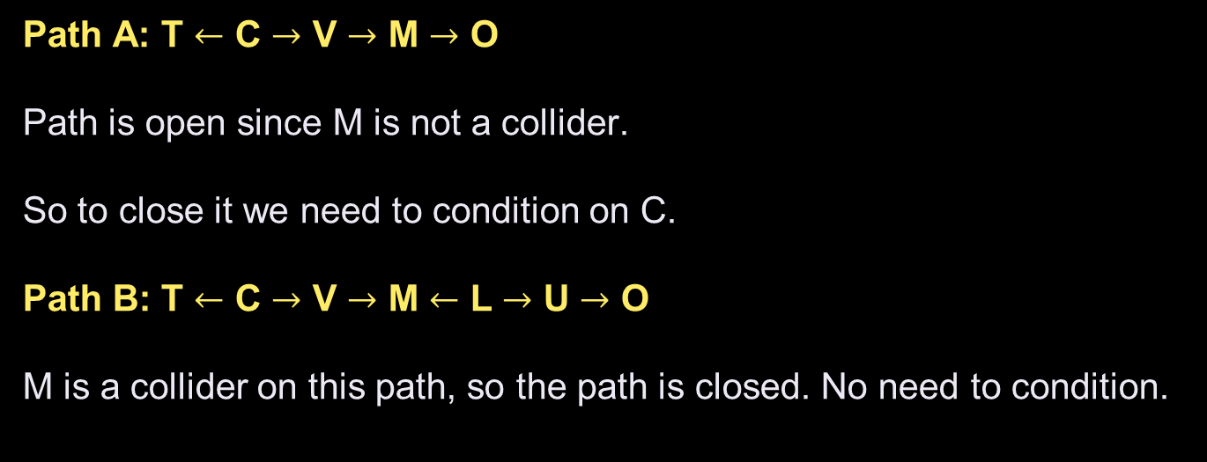
Collider logic is path-specific
Path A: T $←$ C $→$ V $→$ M $→$ O
Path is open since M is not a collider.
So to close it we need to condition on C.
Path B: T $←$ C $→$ V $→$ M $←$ L $→$ U $→$ O
M is a collider on this path, so the path is closed. No need to condition.
Collider present and unconditioned → CLOSED by default.

Slide 46
Key Lesson
Confounder / mediator / collider are path roles, not permanent variable identities.
One node may play different roles on different paths.
Adjustment decisions are made relative to a specific estimand and a specific DAG.
Temporal ordering is necessary information, but it is not sufficient.

Slide 47

What did the graph buy us?
$$Y(t) ⟂ T | X$$
Last class:
Today:
Use a DAG to justify a set X that blocks all backdoor paths.
Then the graphical assumptions support conditional exchangeability for the causal effect of interest.
Graphical identification is the bridge from assumptions to an estimable formula.

Slide 48
After block backdoor paths: adjustment formula
$$E\left[Y\left(t\right)\right] = \sum_{x}{E[Y | T=t, X=x]P(X=x)}$$
ATE = E[Y(1)] − E[Y(0)]
The DAG helps justify WHICH X makes this identification step valid.
Regression, matching, weighting, and g-computation are estimation strategies after identification.

Slide 49
A DAG does not prove causality
The arrows come from scientific knowledge, design, temporal order, and assumptions.
Observed data generally cannot determine a unique causal DAG by itself.
Multiple DAGs can imply the same set of observed conditional independences.
A correct-looking picture is not a substitute for substantive justification.
DAGs make assumptions visible; they do not make them automatically true.

Slide 50
Unmeasured confounding: Hidden U
U
T
Y
If U is unmeasured, ordinary adjustment cannot block $T ← U → Y$.

Slide 51
Measuring poorly is not same as measuring it
C*
true confounder
W
noisy measure
T
Y
Conditioning on W may leave residual confounding because W does not perfectly recover C*.

Slide 52
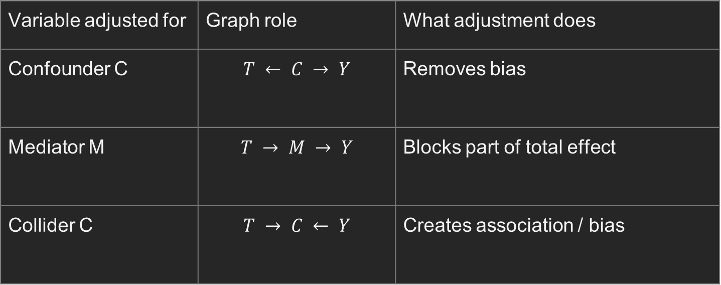
Summary
Variable adjusted for | Graph role | What adjustment does
Confounder C | $$T ← C → Y$$ | Removes bias
Mediator M | $$T → M → Y$$ | Blocks part of total effect
Collider C | $$T → C ← Y$$ | Creates association / bias
Regression syntax cannot tell you which causal role a covariate has.

Slide 53
Two branches of analysis
CAUSAL ANALYSIS WITH A DAG
CAUSAL DISCOVERY
Start with a scientifically motivated graph.
Use it to reason about identification, adjustment, and bias.
Use patterns of conditional independence and assumptions to learn aspects of graph structure.
Outputs may be equivalence classes (CPDAGs/PAGs), not one certain DAG.

Slide 54
R Lab Simulation
• Confounding can make a treatment effect look too large or too small.
• Adjusting for the right backdoor variable can recover the causal effect.
• Adjusting for a mediator changes the estimand: total effect → direct effect.
• Adjusting for a collider can create bias, even when treatment is randomized.
• The same DAG can lead to different conditioning choices for d-separation versus causal adjustment.
Predict first → run the code → explain the result from the DAG.

Slide 55
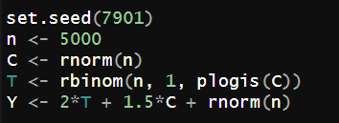
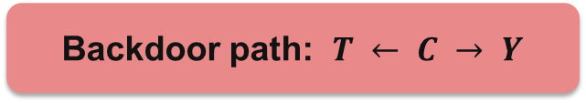
Simulation 1
C = baseline risk
C
T
Y
Treatment
Outcome
Backdoor path: $T ← C → Y$
True treatment effect in the simulation = 2
Will the crude model overestimate or underestimate the effect?

Slide 56
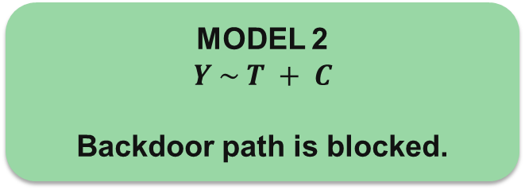
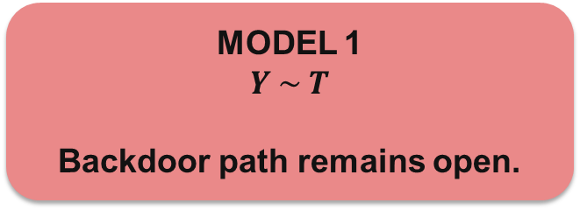

Simulation 1
set.seed(7901)
n <- 5000
C <- rnorm(n)
T <- rbinom(n, 1, plogis(C))
Y <- 2*T + 1.5*C + rnorm(n)
fit_crude <- lm(Y ~ T)
fit_adj <- lm(Y ~ T + C)
coef(fit_crude)["T"] – 3.18
coef(fit_adj)["T"] – 1.99
MODEL 1
$Y \sim T$
Backdoor path remains open.
MODEL 2
$Y \sim T + C$
Backdoor path is blocked.
Adjusted coefficient $≈$ 2

Slide 57
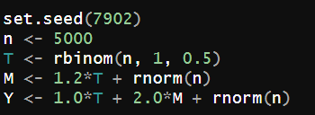
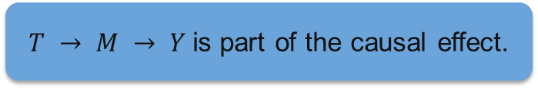
Simulation 2
M = mediator
M
T
Y
Treatment
Outcome
$T → M → Y$is part of the causal effect.
Target total effect? Do NOT condition on M.

Slide 58
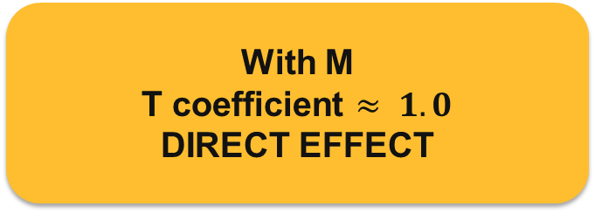
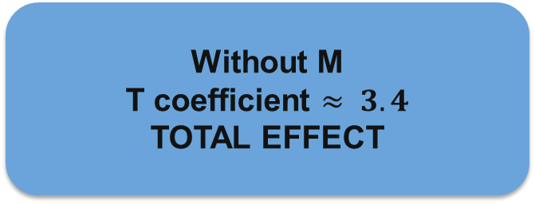
Simulation 2
set.seed(7902)
n <- 5000
T <- rbinom(n, 1, 0.5)
M <- 1.2*T + rnorm(n)
Y <- 1.0*T + 2.0*M + rnorm(n)
fit_total <- lm(Y ~ T)
fit_direct <- lm(Y ~ T + M)
coef(fit_total)["T"] - 3.38
coef(fit_direct)["T"] - 0.98
Without M
T coefficient $≈ 3.4$
TOTAL EFFECT
With M
T coefficient $≈ 1.0$
DIRECT EFFECT
Adding a covariate can change the scientific question.

Slide 59
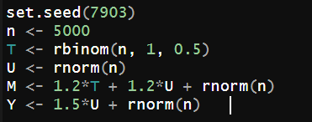
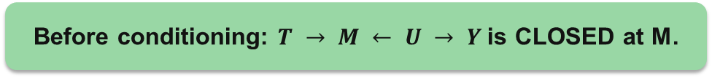
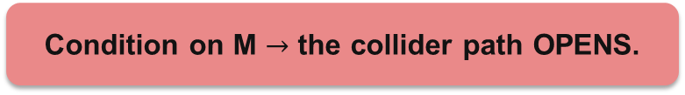
Simulation 3
Collider
U
M
T
Y
Treatment
Outcome
Before conditioning: $T → M ← U → Y$is CLOSED at M.
Condition on M $→$ the collider path OPENS.

Slide 60
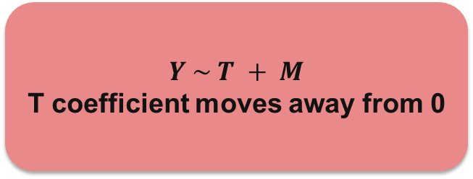
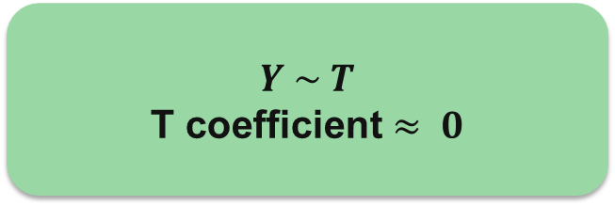
Simulation 3
set.seed(7903)
n <- 5000
T <- rbinom(n, 1, 0.5)
U <- rnorm(n)
M <- 1.2*T + 1.2*U + rnorm(n)
Y <- 1.5*U + rnorm(n) # no effect of T
fit_unadj <- lm(Y ~ T)
fit_col <- lm(Y ~ T + M)
coef(fit_unadj)["T"] - 0.009
coef(fit_col)["T"] - -0.867
$Y \sim T$
T coefficient $≈ 0$
$Y \sim T + M$
T coefficient moves away from 0
Randomization does not protect against bad post-treatment adjustment.

Slide 61
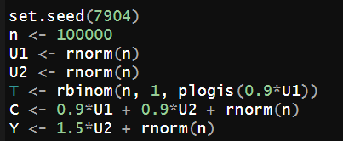
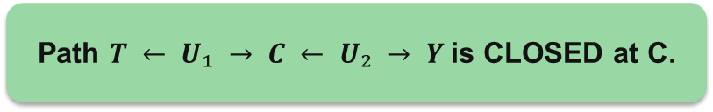
Simulation 4
U₁
U₂
C
T
Y
Path $T ← U₁ → C ← U₂ → Y$is CLOSED at C.
Adjusting for C OPENS the path.

Slide 62
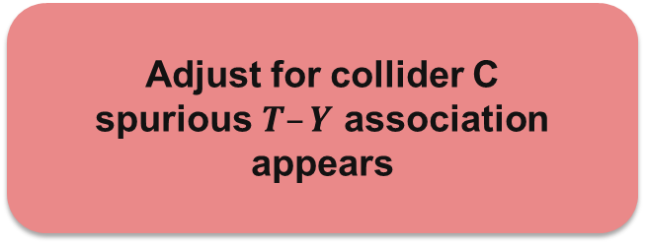
Simulation 4
set.seed(7904)
n <- 100000
U1 <- rnorm(n)
U2 <- rnorm(n)
T <- rbinom(n, 1, plogis(0.9*U1))
C <- 0.9*U1 + 0.9*U2 + rnorm(n)
Y <- 1.5*U2 + rnorm(n)
fit0 <- lm(Y ~ T)
fit1 <- lm(Y ~ T + C)
coef(fit0)["T"] : 0.01
coef(fit1)["T"] : -0.35
No adjustment
T coefficient ≈ 0
Adjust for collider C
spurious $T–Y$ association appears
Timing is not enough. We need the causal role of the variable.

Slide 63
d-Separation vs Backdoor Adjustment
d-SEPARATION
BACKDOOR ADJUSTMENT
Question:
Can we make T and Y conditionally independent?
Question:
What should we condition on to identify the total effect of T on Y?
Goal:
Block ALL paths.
Goal:
Block NONCAUSAL backdoor paths; preserve causal paths.

Slide 64
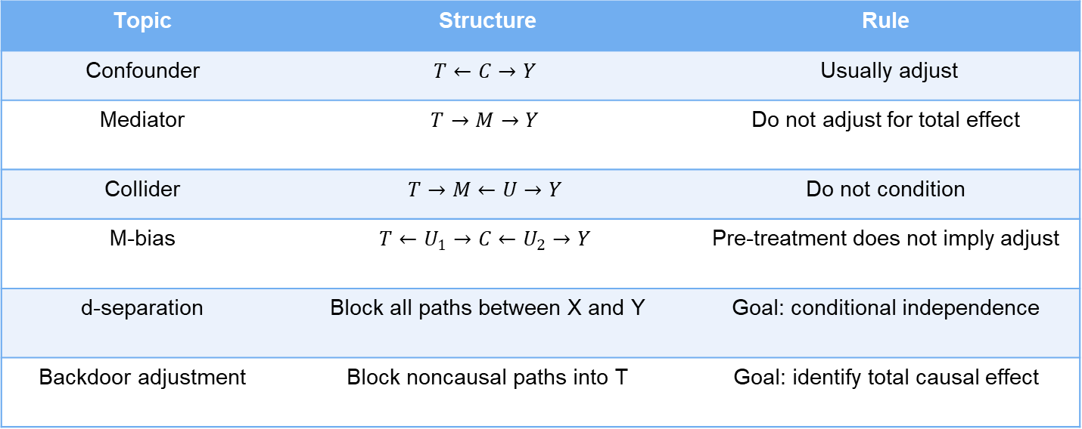
Summary
Topic | Structure | Rule
Confounder | $$T←C→Y$$ | Usually adjust
Mediator | $$T→M→Y$$ | Do not adjust for total effect
Collider | $$T→M←U→Y$$ | Do not condition
M-bias | $$T←U_{1}→C←U_{2}→Y$$ | Pre-treatment does not imply adjust
d-separation | Block all paths between X and Y | Goal: conditional independence
Backdoor adjustment | Block noncausal paths into T | Goal: identify total causal effect

Slide 65
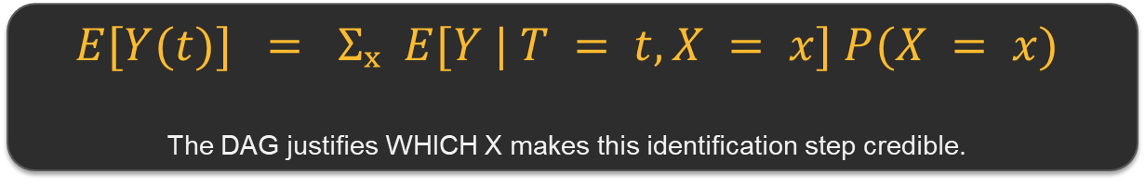
From Adjustment to Estimation
Causal
question
DAG /
assumptions
Adjustment
set X
g-formula
Estimation
→
→
→
→
We now know WHAT to adjust for. How do we use the observed data to estimate the causal effect?
$$E[Y(t)] = Σₓ E[Y | T = t, X = x] P(X = x)$$
The DAG justifies WHICH X makes this identification step credible.
Next question: Is the regression coefficient of T automatically the ATE? Only in special cases.

Slide 66
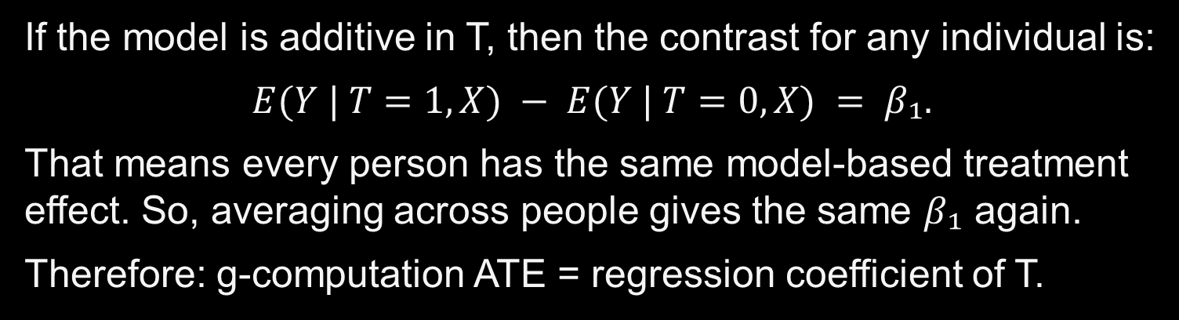

g-computation not same as regression
Simple additive model:
$E(Y | T, X) = β₀ + β₁T + β₂X$
If the model is additive in T, then the contrast for any individual is:
$$E(Y | T=1, X) − E(Y | T=0, X) = β₁.$$
That means every person has the same model-based treatment effect. So, averaging across people gives the same $β₁$ again.
Therefore: g-computation ATE = regression coefficient of T.

Slide 67
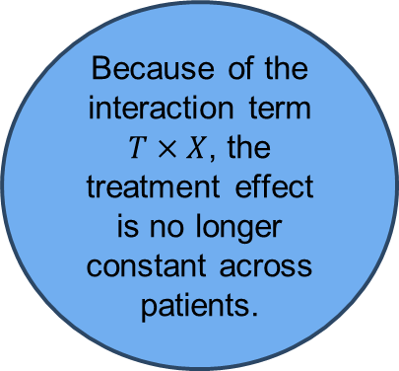
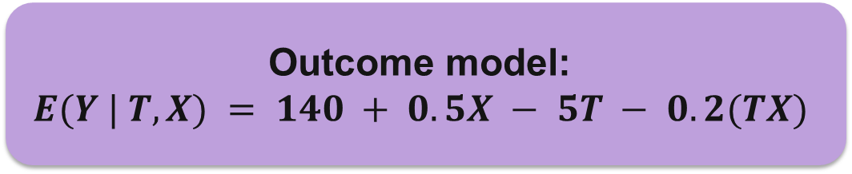
g-computation not same as regression
Clinical example
Outcome model:
$E(Y | T, X) = 140 + 0.5X − 5T − 0.2(TX)$
T = 1: antihypertensive drug; T = 0: no drug
Y = post-treatment systolic blood pressure
X = Age − 50
Suppose the effect of treatment depends on age.
Because of the interaction term $T×X$, the treatment effect is no longer constant across patients.

Slide 68
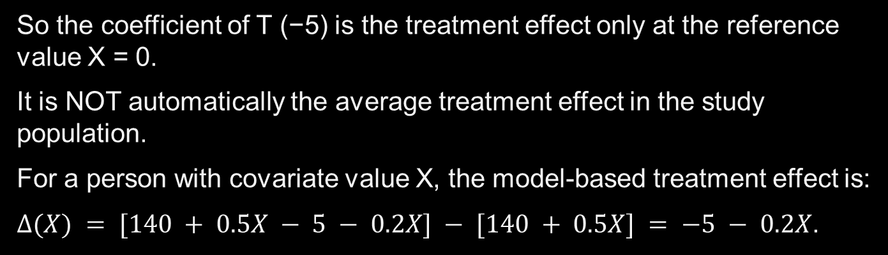
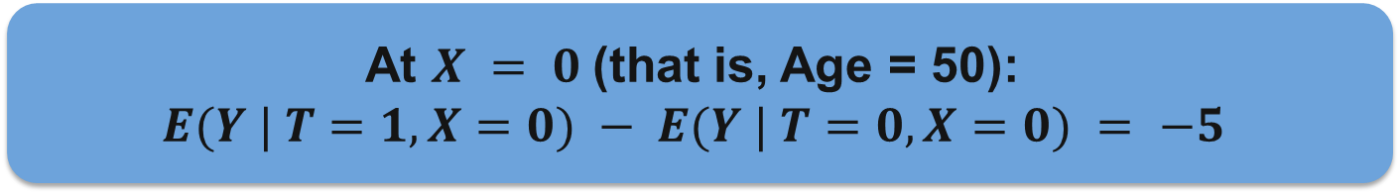
g-computation not same as regression
At $X = 0$(that is, Age = 50):
$E(Y | T=1, X=0) − E(Y | T=0, X=0) = −5$
So the coefficient of T (−5) is the treatment effect only at the reference value X = 0.
It is NOT automatically the average treatment effect in the study population.
For a person with covariate value X, the model-based treatment effect is:
$Δ(X) = [140 + 0.5X − 5 − 0.2X] − [140 + 0.5X] = −5 − 0.2X$.

Slide 69

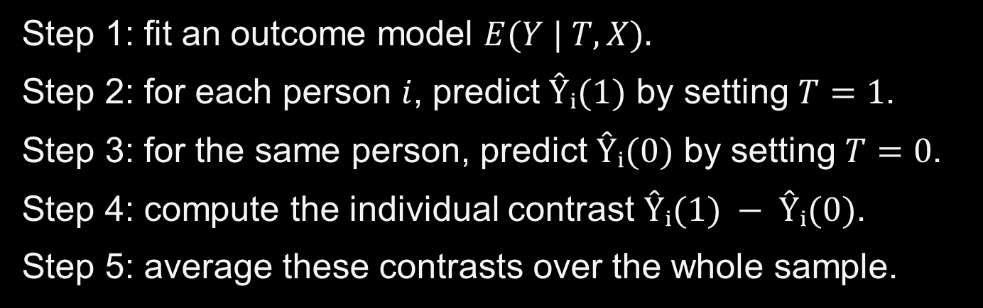
What does g-computation do?
Step 1: fit an outcome model $E(Y | T, X).$
Step 2: for each person $i$, predict $Ŷᵢ(1)$ by setting $T=1$.
Step 3: for the same person, predict $Ŷᵢ(0)$ by setting $T=0$.
Step 4: compute the individual contrast $Ŷᵢ(1) − Ŷᵢ(0)$.
Step 5: average these contrasts over the whole sample.
$$ATE_{g} = (1/n) Σ [ Ŷᵢ(1) − Ŷᵢ(0) ]$$

Slide 70
Simple Illustration I
Patient
Age
X = Age−50
Predicted effect = −5 − 0.2X
A
50
0
−5
B
60
10
−7
C
70
20
−9
g-computation average = (−5 − 7 − 9)/3 = −7

Slide 71
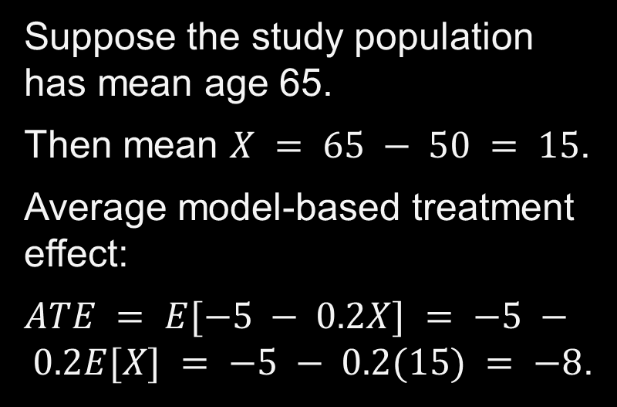
Simple Illustration II
Suppose the study population has mean age 65.
Then mean $X = 65 − 50 = 15$.
Average model-based treatment effect:
$ATE = E[−5 − 0.2X] = −5 − 0.2E[X] = −5 − 0.2(15) = −8$.
Regression coefficient of T = −5
g-computation ATE = −8
These differ because treatment effect varies with X.

Slide 72
g-computation vs regression
Regression coefficient of T is a conditional effect tied to the chosen parameterization.
g-computation targets a marginal causal estimand: average over the covariate distribution.
They are equal in special cases, especially a simple additive linear model with no interaction.
They generally differ with interactions, nonlinear models, logistic regression, splines, or machine learning.
Therefore: g-computation is NOT “just the T coefficient”.
regression = model
g-computation = model + counterfactual prediction + averaging

Slide 73
Short R workflow
fit <- lm(Y ~ T * X, data = dat)
dat1 <- transform(dat, T = 1)
dat0 <- transform(dat, T = 0)
y1hat <- predict(fit, newdata = dat1)
y0hat <- predict(fit, newdata = dat0)
ate_g <- mean(y1hat - y0hat)
Notice: we didn’t use coef(fit)["T"] as the ATE.
We predicted both counterfactual outcomes for everyone and then averaged.

Slide 74
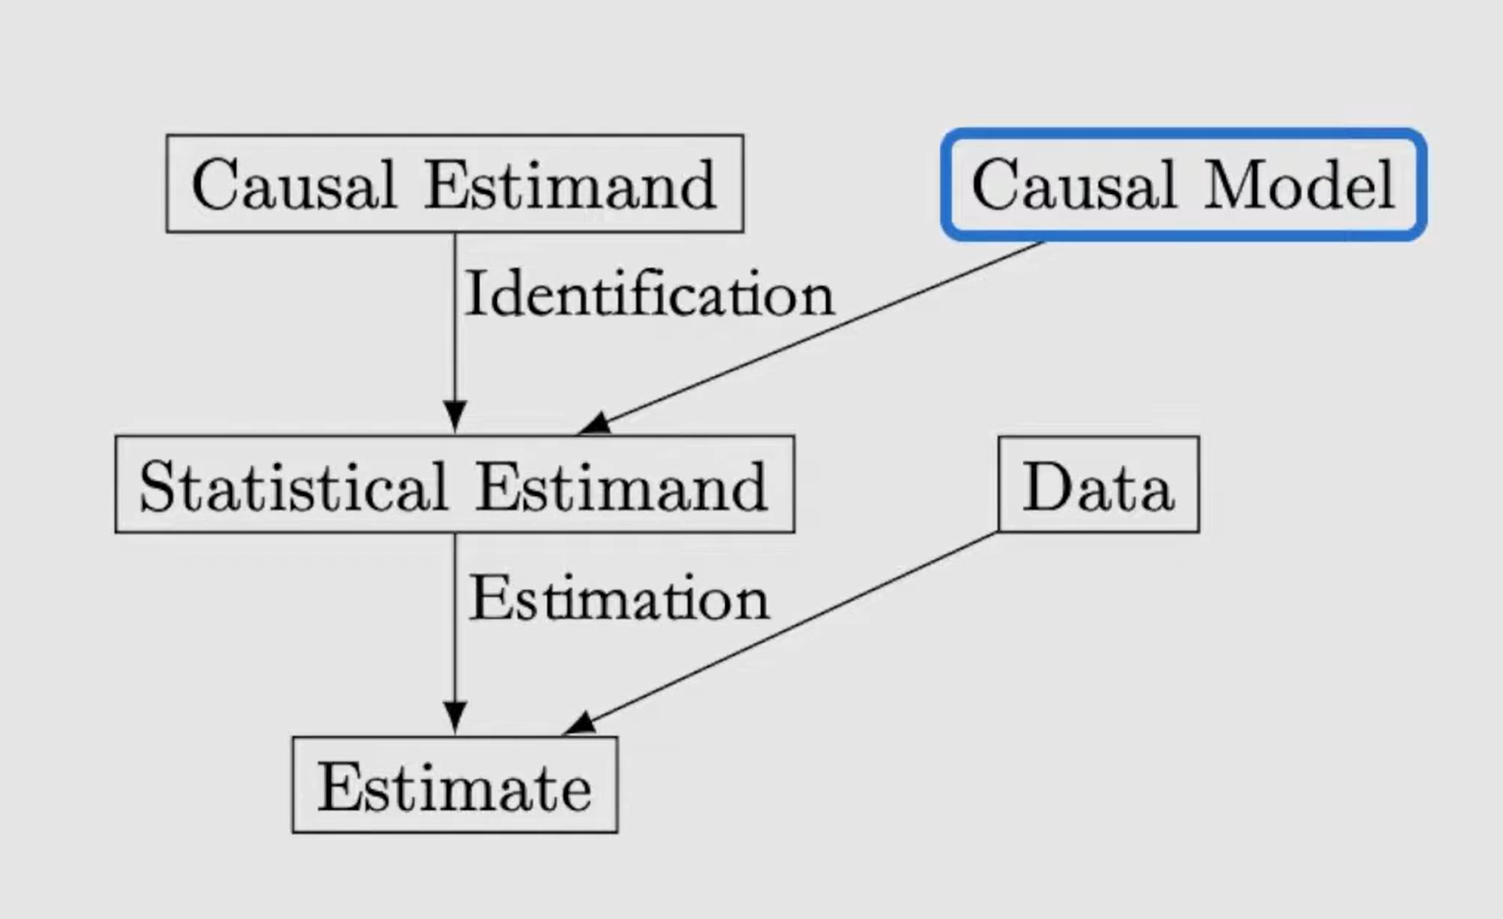
Structural Causal Models (SCM)

Slide 75
Structural Causal Models (SCM)
From a causal picture to a model of how the world generates variables
DAG = causal map
SCM = causal map + generating rules
We will learn how to represent an intervention such as “force treatment = 1.”

Slide 76
Structural Causal Models (SCM)
A DAG already tells us:
SCM adds something new:
which variables directly cause which.
which paths are causal or noncausal.
what we may need to adjust for.
a rule for how each variable is generated.
a precise meaning for “intervene”.
a way to define the same person under different treatment choices.
SCM makes “what if we changed T?” mathematically precise.

Slide 77
Example
Clinical question:
Does an intensive blood-pressure treatment lower systolic BP after 3 months?
C
baseline severity
T
Y
treatment
3-month BP

Slide 78
Example
C → T
Baseline severity can influence which treatment is chosen.
C → Y
Baseline severity can also influence the outcome.
T → Y
Treatment can causally change the outcome.
The DAG gives direction, but not yet the actual rule for generating T or Y.

Slide 79
Example
The graph does not tell us:
How strongly does severity affect treatment choice?
How strongly does treatment change blood pressure?
What other background factors affect treatment or outcome?
Exactly what should we change when we say “give treatment to everyone”?
SCM supplies those generating rules.

Slide 80
SCM
1
Generate baseline severity C
2
Generate treatment T using C + other factors
3
Generate outcome Y using T, C + other factors
Each recipe says: “given the direct causes of this variable, how is this variable produced?”

Slide 81
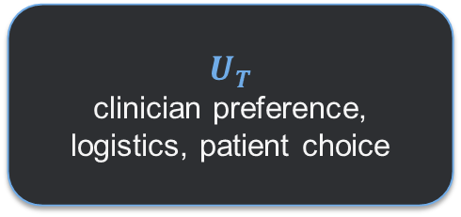
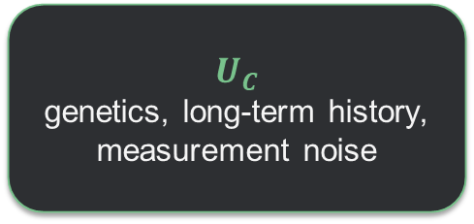
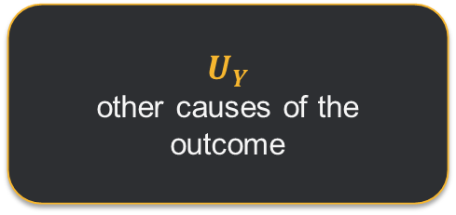
U Variables
U means background factors not explicitly represented as nodes in our simple DAG.
$$U_{C}$$
genetics, long-term history, measurement noise
$$U_{T}$$
clinician preference, logistics, patient choice
$$U_{Y}$$
other causes of the outcome
We use U because no model includes every cause in the universe.
Important: a U variable can be measured or unmeasured in reality. Here it simply means “outside the simplified system we drew.”

Slide 82
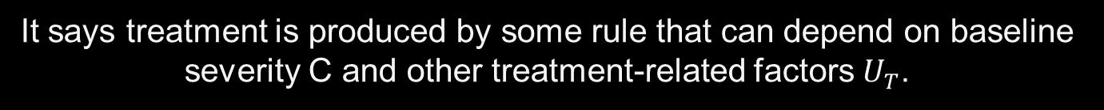


Treatment Assignment
$$T := f_{T}(C, U_{T})$$
This does NOT mean treatment is random.
It says treatment is produced by some rule that can depend on baseline severity C and other treatment-related factors $U_{T}$.
$f_{T}$ = Treatment Decision Rule

Slide 83

Outcome
$$Y = 120 + 10C − 6T + U_{Y}$$
One possible numerical rule:
Every 1-unit increase in baseline severity raises Y by 10 units.
Treatment lowers Y by 6 units, holding the other causes fixed.
$U_{Y}$represents other causes of Y not shown explicitly.

Slide 84
What makes an SCM causal
A regression can describe association.
An SCM makes an additional scientific claim:
If we externally change one variable, the other generating rules remain the rules of the system.
That is what allows the model to answer intervention questions.

Slide 85


Key Operation: Intervention
Normal observational world:
Intervention world:
$$T = f_{T}(C, U_{T})$$
$$T := 1$$
Treatment follows the usual decision process.
We replace the treatment rule and force treatment to 1.
Everything else in the SCM stays the same.

Slide 86
Do Calculus
“Set treatment to 1 from outside the system.”
do(T = 1)
Do not let baseline severity decide T.
Do not let clinician preference decide T.
Simply assign T = 1, then let the rest of the model run.
Before intervention
After do(T = 1)
C
T
C
T=1
Y
Y

Slide 87
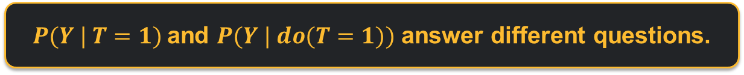
Intervention vs Conditioning
Conditioning: T = 1
Look at the people who happened to receive treatment.
Their baseline characteristics may differ from untreated people.
Intervention: do(T = 1)
Force treatment to 1 for the target population.
The usual treatment-selection process is bypassed.
$P(Y | T=1)$and $P(Y | do(T=1))$ answer different questions.

Slide 88
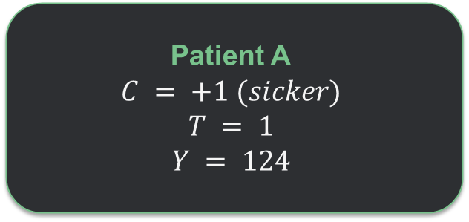


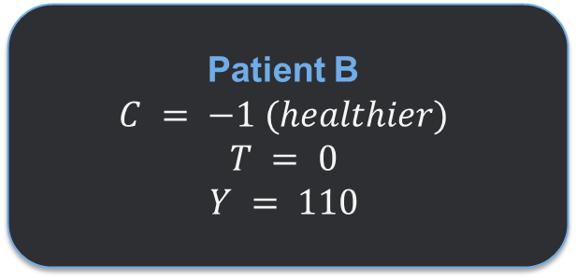
Numerical Example
Outcome rule:
$$Y = 120 + 10C − 6T$$
Patient A
$$C = +1 (sicker)$$
Patient B
$$C = −1 (healthier)$$
Observed comparison:
$$124 − 110 = +14$$
But treatment itself lowers Y by 6. Baseline severity created the misleading observed difference.

Slide 89
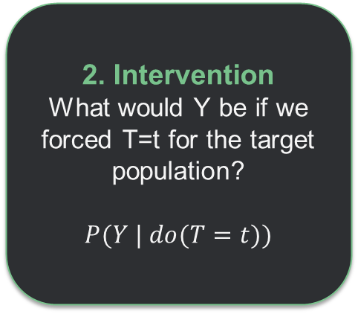
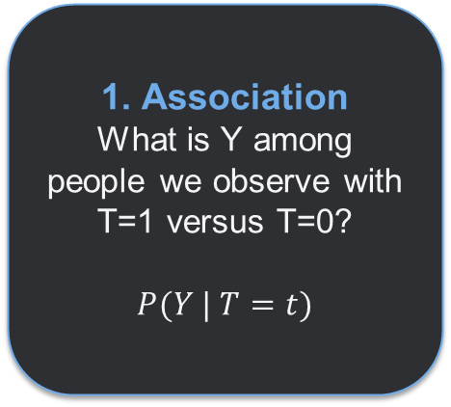
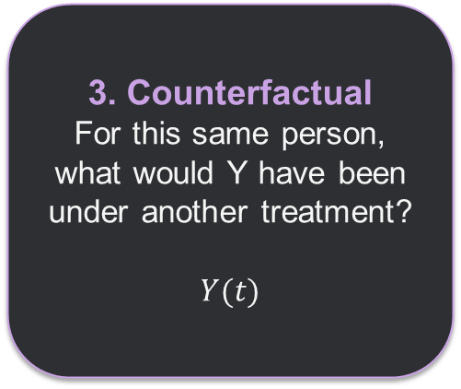
Three Different Questions
1. Association
What is Y among people we observe with T=1 versus T=0?
$P(Y | T=t)$
2. Intervention
What would Y be if we forced T=t for the target population?
$P(Y | do(T=t))$
3. Counterfactual
For this same person, what would Y have been under another treatment?
$Y(t)$
SCM gives one framework for all three, but they are not the same question.

Slide 90
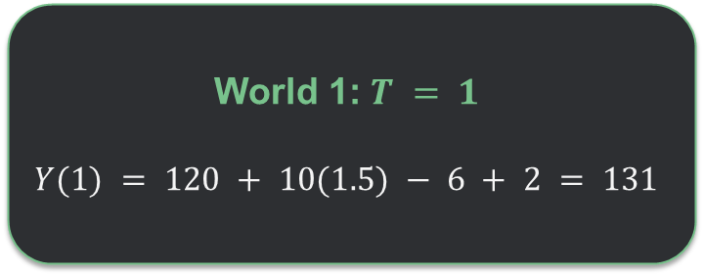

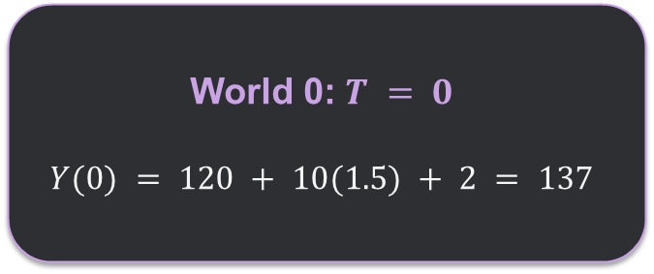
Counterfactual: Same person, Different treatment
Suppose one person has:
$$C = 1.5 U_{Y} = 2$$
Keep these person-specific background factors fixed.
World 1: $T = 1$
$$Y(1) = 120 + 10(1.5) − 6 + 2 = 131$$
World 0: $T = 0$
$$Y(0) = 120 + 10(1.5) + 2 = 137$$
Y(1) − Y(0) = −6

Slide 91
g-Computation does the same thing
1
set T = 1 and predict Y
2
set T = 0 and predict Y
3
average the difference
That procedure is trying to emulate the two intervention worlds described by the SCM.
The estimation model is not the SCM itself, but the intervention logic is the same.

Slide 92
Simulation: Build Data from SCM
P(T=1 | C) = logistic(1.2C)
Y = 120 + 10C − 6T + ε
C ~ Normal(0,1)
Interpretation:
Sicker patients (larger C) are more likely to receive treatment.
Sicker patients also have higher Y.
Treatment truly lowers Y by 6 units.
True intervention effect = −6

Slide 93
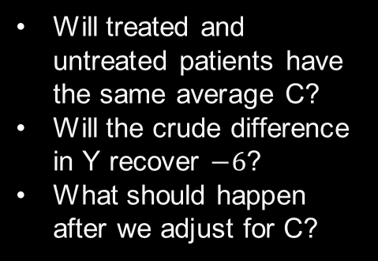
Simulation: Build Data from SCM
set.seed(7900)
n <- 5000
C <- rnorm(n)
p <- plogis(1.2*C)
T <- rbinom(n, 1, p)
eps <- rnorm(n, sd = 5)
Y <- 120 + 10*C - 6*T + eps
dat <- data.frame(C, T, Y)
Before fitting anything, predict:
Will treated and untreated patients have the same average C?
Will the crude difference in Y recover $−6$?
What should happen after we adjust for C?

Slide 94
Simulation: Build Data from SCM
Observed mean Y
Crude observed difference:
118.77
118.77 − 115.25 = +3.52
115.25
But the true treatment effect is −6.
Wrong sign!
T = 0
T = 1
One simulated realization; exact sample numbers vary slightly with the random-number generator.

Slide 95
Simulation adjust for Common Cause C
fit_crude <- lm(Y ~ T, data = dat)
fit_adj <- lm(Y ~ T + C, data = dat)
coef(fit_crude)["T"]
# about +3.5
coef(fit_adj)["T"]
# about -6.0
Crude model
T coefficient ≈ +3.5
Adjusted model
T coefficient ≈ −6.0
The adjusted model recovers the truth here because the simulation satisfies the required assumptions and the outcome rule is correctly represented.

Slide 96
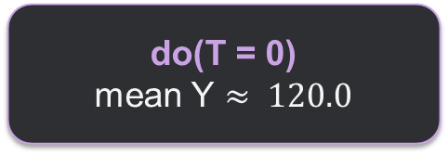
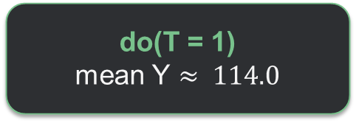

Simulation creates two interventions
# keep each person's C and eps fixed
Y1 <- 120 + 10*C - 6*1 + eps
Y0 <- 120 + 10*C - 6*0 + eps
mean(Y1) # about 114.0
mean(Y0) # about 120.0
mean(Y1 - Y0) # exactly -6
do(T = 1)
mean Y $≈ 114.0$
do(T = 0)
mean Y $≈ 120.0$
ATE = $114 − 120 = −6$

Slide 97
Real data example: job training and later earnings
Causal question: Does participation in the National Supported Work job-training program increase earnings in 1978?
LaLonde / MatchIt data
What was known before treatment?
614
185
429
Age • education • race • marital status
No high-school degree • earnings in 1974 • earnings in 1975
people
treated
controls
Treatment T: job-training participation
Outcome Y: 1978 earnings (re78)
Call these baseline variables X
These variables may affect both program participation and later earnings.

Slide 98
What does SCM add?
Treated
Control
Crude difference
$6,349
$6,984
−$635
But the groups were already different before treatment
Baseline variable
Treated
Control
Age
25.8
28.0
Married
So −$635 is an observed association, not automatically the causal effect of training.
18.9%
51.3%
Black
84.3%
20.3%
1974 earnings
$2,096
$5,619
1975 earnings
$1,532
$2,466

Slide 99


What do observed data say?
A plausible causal story
What we observed
Baseline X
$$E[Y | T=1] − E[Y | T=0]$$
Earnings Y
Training T
What we want causally
$$E[Y | do(T=1)] − E[Y | do(T=0)]$$
SCM tells us what “force training” versus “force no training” means. It does not make −$635 causal; assumptions and appropriate adjustment are still needed.

Slide 100
Next Lesson
SCM gave us a precise target:
E[Y | do(T=1)] − E[Y | do(T=0)]
Next question:
When can we learn that intervention effect from the data we actually observe?
Next: randomized experiments and identification

